Slide 1
Chapter 8-1
Subroutines
计算机系统概论
Introduction to Computing Systems
（01170401）
安虹
han@ustc.edu.cn
2020 Fall
计算机科学与技术学院
School of Computer Science and Technology

Slide 2
Outline
1
1
Review
Review
2
2
From ENIAC to the Stored Program Computer
Subroutines
3
3
A Machine Structure：von Neumann Model
Control Instructions for Subroutines
4
4
Summary
Summary

Slide 3
Subroutines
A subroutine is a program fragment that. . .
  Resides in user space (i.e, not in OS)
  Performs a well-defined task
  Is invoked (called) by a user program
  Returns control to the calling program when finished
Virtues
  Reuse code without re-typing it (and debugging it!)
  Divide task into parts (or among multiple programmers)
  Use vendor-supplied library of useful routines

Slide 4
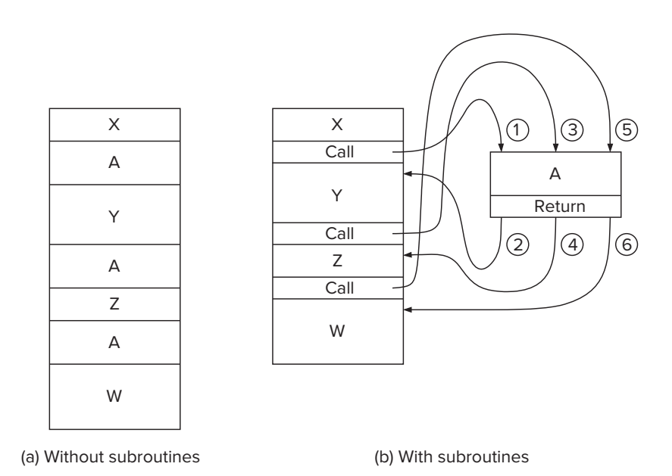
The Call/Return Mechanism

Slide 5
Control Instructions for Subroutines
15
14
13
12
11
10
9
8
7
6
5
4
3
2
1
0
BR
0
0
0
0
n
z
p
PCoffset9
JSR
0
1
0
0
1
PCoffset11
JSRR
0
1
0
0
0
0
0
BaseR
0
0
0
0
0
0
RTI
1
0
0
0
0
0
0
0
0
0
0
0
0
0
0
0
JMP
1
1
0
0
0
0
0
BaseR
0
0
0
0
0
0
RET
1
1
0
0
0
0
0
1
1
1
0
0
0
0
0
0
TRAP
1
1
1
1
0
0
0
0
TrapVector8

Slide 6
JSR

Slide 7
F
D
EA
JSR (PC-Relative)
OP
₁₆
GatePC
₁₆
GateMARMUX
EX
LD.PC
PC
DR
₃
MARMUX
+1
REG FILE
₁₆
₂
PCMUX
₁₆
₁₆
₁₆
₁₆
₁₆
LD.REG
S
[7:0]
SR2
SR2
OUT
SR1
OUT
SR1
SEXT
₊
₃
₃
ADDR2MUX
MUX
MUX
ADDR1MUX
₁₆
₁₆
[10:0]
₁₆
₁₆
₁₆
₁₆
₁₆
SEXT
[8:0]
LD.CC
₁₆
SEXT
FINITE STATE MACHINE
SR2MUX
[5:0]
SEXT
₁₆
N
Z
P
ALUK
_{A}
_{B}
[4:0]
SEXT
₂
ALU
LD.IR
IR
LOGIC
…
₁₆
₁₆
₁₆
RUN
GateALU
₁₆
GateMDR
₁₆
LD.MDR
MDR
MEMORY
MAR
LD.MAR
₁₆
INPUT
OUTPUT
MIO.EN
MUX
₁₆
MEM.EN,R,W

Slide 8
F
D
EA
JSR (PC-Relative)
OP
₁₆
GatePC
₁₆
GateMARMUX
EX
LD.PC
PC
DR
₃
MARMUX
+1
REG FILE
₁₆
₂
PCMUX
₁₆
₁₆
₁₆
₁₆
₁₆
LD.REG
S
[7:0]
SR2
SR2
OUT
SR1
OUT
SR1
SEXT
₊
₃
₃
ADDR2MUX
MUX
MUX
ADDR1MUX
₁₆
₁₆
[10:0]
₁₆
₁₆
₁₆
₁₆
₁₆
SEXT
[8:0]
LD.CC
₁₆
SEXT
FINITE STATE MACHINE
SR2MUX
[5:0]
SEXT
₁₆
N
Z
P
ALUK
_{A}
_{B}
[4:0]
SEXT
₂
ALU
LD.IR
IR
LOGIC
…
₁₆
₁₆
₁₆
RUN
GateALU
₁₆
GateMDR
₁₆
LD.MDR
MDR
MEMORY
MAR
LD.MAR
₁₆
INPUT
OUTPUT
MIO.EN
MUX
₁₆
MEM.EN,R,W

Slide 9
F
D
EA
JSR (PC-Relative)
OP
₁₆
GatePC
₁₆
GateMARMUX
EX
LD.PC
PC
DR
₃
MARMUX
+1
REG FILE
₁₆
₂
PCMUX
₁₆
₁₆
₁₆
₁₆
₁₆
LD.REG
S
[7:0]
SR2
SR2
OUT
SR1
OUT
SR1
SEXT
₊
₃
₃
ADDR2MUX
MUX
MUX
ADDR1MUX
₁₆
₁₆
[10:0]
₁₆
₁₆
₁₆
₁₆
₁₆
SEXT
[8:0]
LD.CC
₁₆
SEXT
FINITE STATE MACHINE
SR2MUX
[5:0]
SEXT
₁₆
N
Z
P
ALUK
_{A}
_{B}
[4:0]
SEXT
₂
ALU
LD.IR
IR
LOGIC
…
₁₆
₁₆
₁₆
RUN
GateALU
₁₆
GateMDR
₁₆
LD.MDR
MDR
MEMORY
MAR
LD.MAR
₁₆
INPUT
OUTPUT
MIO.EN
MUX
₁₆
MEM.EN,R,W

Slide 10
JSR (PC-Relative)
F
D
EA
OP
EX
S
₁₆
GatePC
₁₆
GateMARMUX
LD.PC
PC
DR
₃
MARMUX
+1
REG FILE
₁₆
₂
PCMUX
₁₆
₁₆
₁₆
₁₆
₁₆
LD.REG
[7:0]
SR2
SR2
OUT
SR1
OUT
SR1
SEXT
₊
₃
₃
ADDR2MUX
MUX
MUX
ADDR1MUX
₁₆
₁₆
[10:0]
₁₆
₁₆
₁₆
₁₆
₁₆
SEXT
[8:0]
LD.CC
₁₆
SEXT
FINITE STATE MACHINE
SR2MUX
[5:0]
SEXT
₁₆
N
Z
P
ALUK
_{A}
_{B}
[4:0]
SEXT
₂
ALU
LD.IR
IR
LOGIC
…
₁₆
₁₆
₁₆
RUN
GateALU
₁₆
GateMDR
₁₆
LD.MDR
MDR
MEMORY
MAR
LD.MAR
₁₆
INPUT
OUTPUT
MIO.EN
MUX
₁₆
MEM.EN,R,W

Slide 11
JSR (PC-Relative)
F
D
EA
OP
EX
S
₁₆
GatePC
₁₆
GateMARMUX
LD.PC
PC
DR
₃
MARMUX
+1
REG FILE
₁₆
₂
PCMUX
₁₆
₁₆
₁₆
₁₆
₁₆
LD.REG
[7:0]
SR2
SR2
OUT
SR1
OUT
SR1
SEXT
₊
₃
₃
ADDR2MUX
MUX
MUX
ADDR1MUX
₁₆
₁₆
[10:0]
₁₆
₁₆
₁₆
₁₆
₁₆
SEXT
[8:0]
LD.CC
₁₆
SEXT
FINITE STATE MACHINE
SR2MUX
[5:0]
SEXT
₁₆
N
Z
P
ALUK
_{A}
_{B}
[4:0]
SEXT
₂
ALU
LD.IR
IR
LOGIC
…
₁₆
₁₆
₁₆
RUN
GateALU
₁₆
GateMDR
₁₆
LD.MDR
MDR
MEMORY
MAR
LD.MAR
₁₆
INPUT
OUTPUT
MIO.EN
MUX
₁₆
MEM.EN,R,W

Slide 12
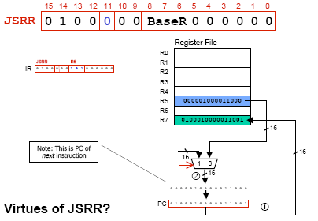
JSRR

Slide 13
F
D
EA
JSRR (Register)
OP
₁₆
GatePC
₁₆
GateMARMUX
EX
LD.PC
PC
DR
₃
MARMUX
+1
REG FILE
₁₆
₂
PCMUX
₁₆
₁₆
₁₆
₁₆
₁₆
LD.REG
S
[7:0]
SR2
SR2
OUT
SR1
OUT
SR1
SEXT
₊
₃
₃
ADDR2MUX
MUX
MUX
ADDR1MUX
₁₆
₁₆
[10:0]
₁₆
₁₆
₁₆
₁₆
₁₆
SEXT
[8:0]
LD.CC
₁₆
SEXT
FINITE STATE MACHINE
SR2MUX
[5:0]
SEXT
₁₆
N
Z
P
ALUK
_{A}
_{B}
[4:0]
SEXT
₂
ALU
LD.IR
IR
LOGIC
…
₁₆
₁₆
₁₆
RUN
GateALU
₁₆
GateMDR
₁₆
LD.MDR
MDR
MEMORY
MAR
LD.MAR
₁₆
INPUT
OUTPUT
MIO.EN
MUX
₁₆
MEM.EN,R,W

Slide 14
F
D
EA
JSRR (Register)
OP
₁₆
GatePC
₁₆
GateMARMUX
EX
LD.PC
PC
DR
₃
MARMUX
+1
REG FILE
₁₆
₂
PCMUX
₁₆
₁₆
₁₆
₁₆
₁₆
LD.REG
S
[7:0]
SR2
SR2
OUT
SR1
OUT
SR1
SEXT
₊
₃
₃
ADDR2MUX
MUX
MUX
ADDR1MUX
₁₆
₁₆
[10:0]
₁₆
₁₆
₁₆
₁₆
₁₆
SEXT
[8:0]
LD.CC
₁₆
SEXT
FINITE STATE MACHINE
SR2MUX
[5:0]
SEXT
₁₆
N
Z
P
ALUK
_{A}
_{B}
[4:0]
SEXT
₂
ALU
LD.IR
IR
LOGIC
…
₁₆
₁₆
₁₆
RUN
GateALU
₁₆
GateMDR
₁₆
LD.MDR
MDR
MEMORY
MAR
LD.MAR
₁₆
INPUT
OUTPUT
MIO.EN
MUX
₁₆
MEM.EN,R,W

Slide 15
F
D
EA
JSRR (Register)
OP
₁₆
GatePC
₁₆
GateMARMUX
EX
LD.PC
PC
DR
₃
MARMUX
+1
REG FILE
₁₆
₂
PCMUX
₁₆
₁₆
₁₆
₁₆
₁₆
LD.REG
S
[7:0]
SR2
SR2
OUT
SR1
OUT
SR1
SEXT
₊
₃
₃
ADDR2MUX
MUX
MUX
ADDR1MUX
₁₆
₁₆
[10:0]
₁₆
₁₆
₁₆
₁₆
₁₆
SEXT
[8:0]
LD.CC
₁₆
SEXT
FINITE STATE MACHINE
SR2MUX
[5:0]
SEXT
₁₆
N
Z
P
ALUK
_{A}
_{B}
[4:0]
SEXT
₂
ALU
LD.IR
IR
LOGIC
…
₁₆
₁₆
₁₆
RUN
GateALU
₁₆
GateMDR
₁₆
LD.MDR
MDR
MEMORY
MAR
LD.MAR
₁₆
INPUT
OUTPUT
MIO.EN
MUX
₁₆
MEM.EN,R,W

Slide 16
JSRR (Register)
F
D
EA
OP
EX
S
₁₆
GatePC
₁₆
GateMARMUX
LD.PC
PC
DR
₃
MARMUX
+1
REG FILE
₁₆
₂
PCMUX
₁₆
₁₆
₁₆
₁₆
₁₆
LD.REG
[7:0]
SR2
SR2
OUT
SR1
OUT
SR1
SEXT
₊
₃
₃
ADDR2MUX
MUX
MUX
ADDR1MUX
₁₆
₁₆
[10:0]
₁₆
₁₆
₁₆
₁₆
₁₆
SEXT
[8:0]
LD.CC
₁₆
SEXT
FINITE STATE MACHINE
SR2MUX
[5:0]
SEXT
₁₆
N
Z
P
ALUK
_{A}
_{B}
[4:0]
SEXT
₂
ALU
LD.IR
IR
LOGIC
…
₁₆
₁₆
₁₆
RUN
GateALU
₁₆
GateMDR
₁₆
LD.MDR
MDR
MEMORY
MAR
LD.MAR
₁₆
INPUT
OUTPUT
MIO.EN
MUX
₁₆
MEM.EN,R,W

Slide 17
JSRR (Register)
F
D
EA
OP
EX
S
₁₆
GatePC
₁₆
GateMARMUX
LD.PC
PC
DR
₃
MARMUX
+1
REG FILE
₁₆
₂
PCMUX
₁₆
₁₆
₁₆
₁₆
₁₆
LD.REG
[7:0]
SR2
SR2
OUT
SR1
OUT
SR1
SEXT
₊
₃
₃
ADDR2MUX
MUX
MUX
ADDR1MUX
₁₆
₁₆
[10:0]
₁₆
₁₆
₁₆
₁₆
₁₆
SEXT
[8:0]
LD.CC
₁₆
SEXT
FINITE STATE MACHINE
SR2MUX
[5:0]
SEXT
₁₆
N
Z
P
ALUK
_{A}
_{B}
[4:0]
SEXT
₂
ALU
LD.IR
IR
LOGIC
…
₁₆
₁₆
₁₆
RUN
GateALU
₁₆
GateMDR
₁₆
LD.MDR
MDR
MEMORY
MAR
LD.MAR
₁₆
INPUT
OUTPUT
MIO.EN
MUX
₁₆
MEM.EN,R,W

Slide 18
RET instruction
RET – return instruction
  How to return
    Place address in R7 in PC, Return the execution to the last calling point.
  PC ← (R7)
15 14 13 12
11 10 9 8 7 6
5 4 3 2 1 0
RET
(JMP R7)
1 1 0 0
0 0 0
1 1 1
0 0 0 0 0 0

Slide 19
Example: Negate the value in R0
TwosComp NOT R0,R0 ;flip bits
ADD R0,R0,#1 ;add one
RET ;return to caller
To call from a program
;need to compute R4 = R1-R3
ADD R0,R3,#0 ;copy R3 to R0
JSR TwosComp ;negate
ADD R4,R1,R0 ;add to R1
...

Slide 20
Using Subroutines
Programmer must know
  Address: or at least a label that will be bound to its address
  Function: what it does
    NOTE: The programmer does not need to know how the subroutine works, but what changes are visible in the machine’s state after the routine has run
  Arguments: what they are and where they are placed
  Return values: what they are and where they are placed

Slide 21
Passing Information To Subroutines
Argument(s)
  Value passed in to a subroutine is called an argument
  This is a value needed by the subroutine to do its job
  Examples
    TwosComp: R0 is number to be negated
    OUT: R0 is character to be printed
    PUTS: R0 is address of string to be printed
How?
  In registers (simple, fast, but limited number)
  In memory (many, but awkward, expensive)
  Both

Slide 22
Getting Values From Subroutines
Return Values
  A value passed out of a subroutine is called a return value
  This is the value that you called the subroutine to compute
  Examples
    TwosComp: negated value is returned in R0
    GETC: character read from the keyboard is returned in R0
How?
  Registers, memory, or both
  Single return value in register most common

Slide 23
Saving and Restore Registers
Like service routines, must save and restore registers
  Who saves what is part of the calling convention
Generally use “callee-save” strategy, except for return values
  Same as trap service routines
  Save anything that subroutine alters internally that shouldn’t be visible when the subroutine returns
  Restore incoming arguments to original values (unless overwritten by return value)
Remember
  You MUST save R7 if you call any other subroutine or trap
  Otherwise, you won’t be able to return!

Slide 24
Subroutine Template
01 SUB_NAME
02 ;Register Saving
03 ST R0, SUB_R0
04 ST R1, SUB_R1
05 …
06 ST R6, SUB_R6
07 ST R7, SUB_R7;Return address
08
09 ;***Code***
10
11 ;Register Restoring
12 LD R0, SUB_R0
13 LD R1, SUB_R1
14 …
15 LD R6, SUB_R6
16 LD R7, SUB_R7 ;Return address
17 RET

